Slide 1



Smart rapid production of biogas and compost from organic wastes using an invented Enhanced Duo Reactor (EDR)
PhD student/Inventor:
Petro Mwamlima (P038/T21)
Supervisors (co-inventors):
Prof. Karoli N. Njau
Dr. Mwemezi Rwiza

Slide 2
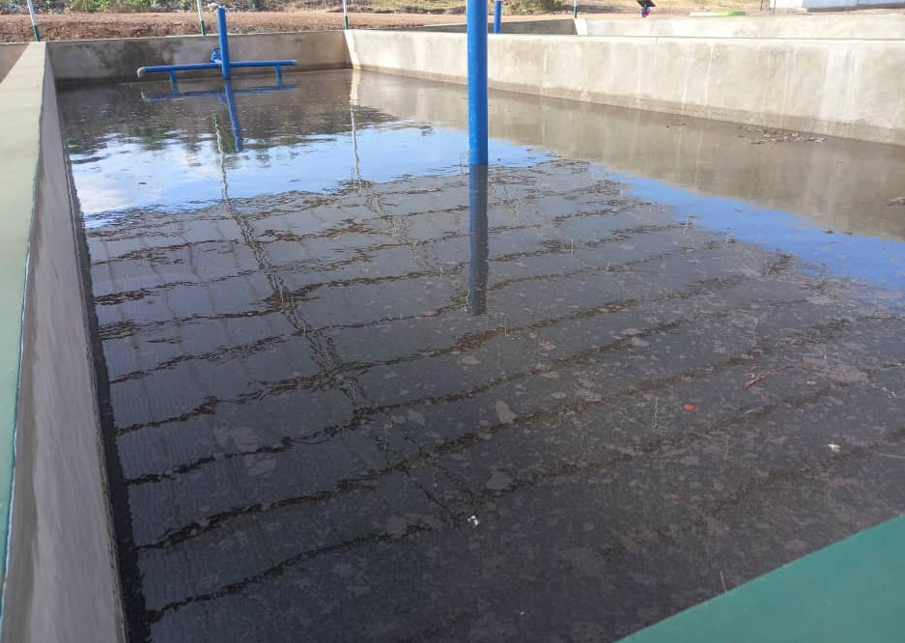
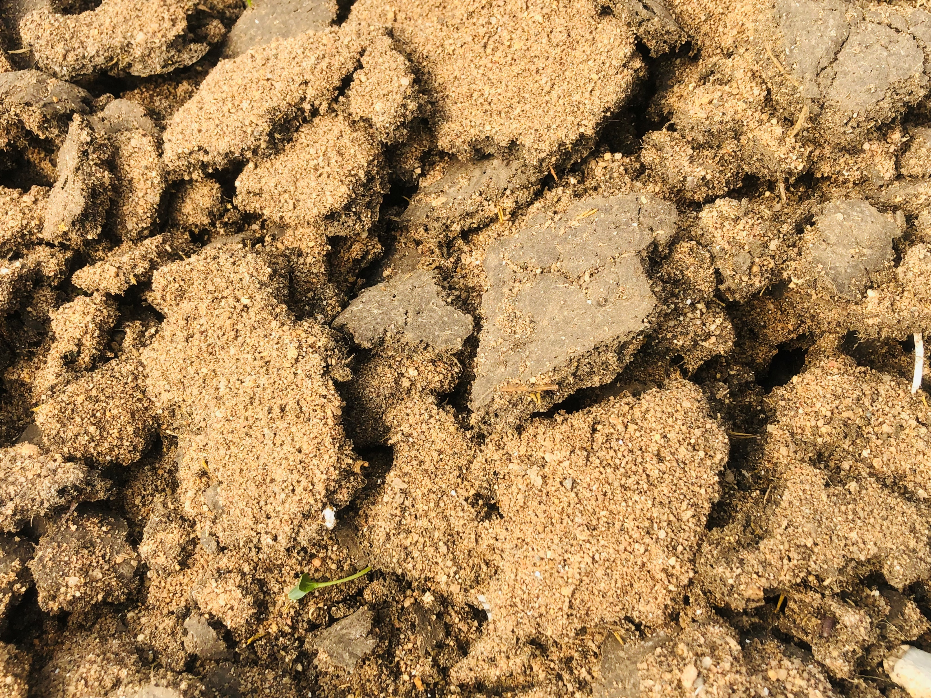
Introduction & Problem Statement
Introduction
Statements
Circular economy/ Waste trading
FS Dewatering Technologies
Belt filter press
Centrifuge
Geo-textile (Geotubes)
Demand for recycling of dewatered FS in the production of organic fertilizer and energy.
Sand drying beds
DEWATS
Limited information is available on the controlled-environment experiments in the production of compost and biogas.
Absence of an automated controlled-environment laboratory facility for conducting composting and biogas production.
Temperature, Moisture content, Feedstock mixing pattern (mixing rate and frequency)
Clogged system
Poor quality dry FS

Slide 3
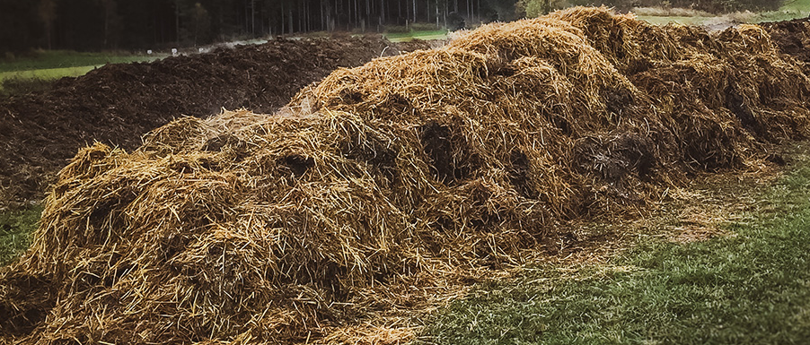
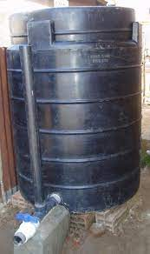
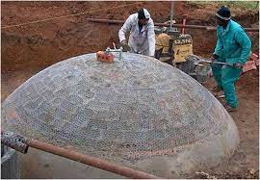
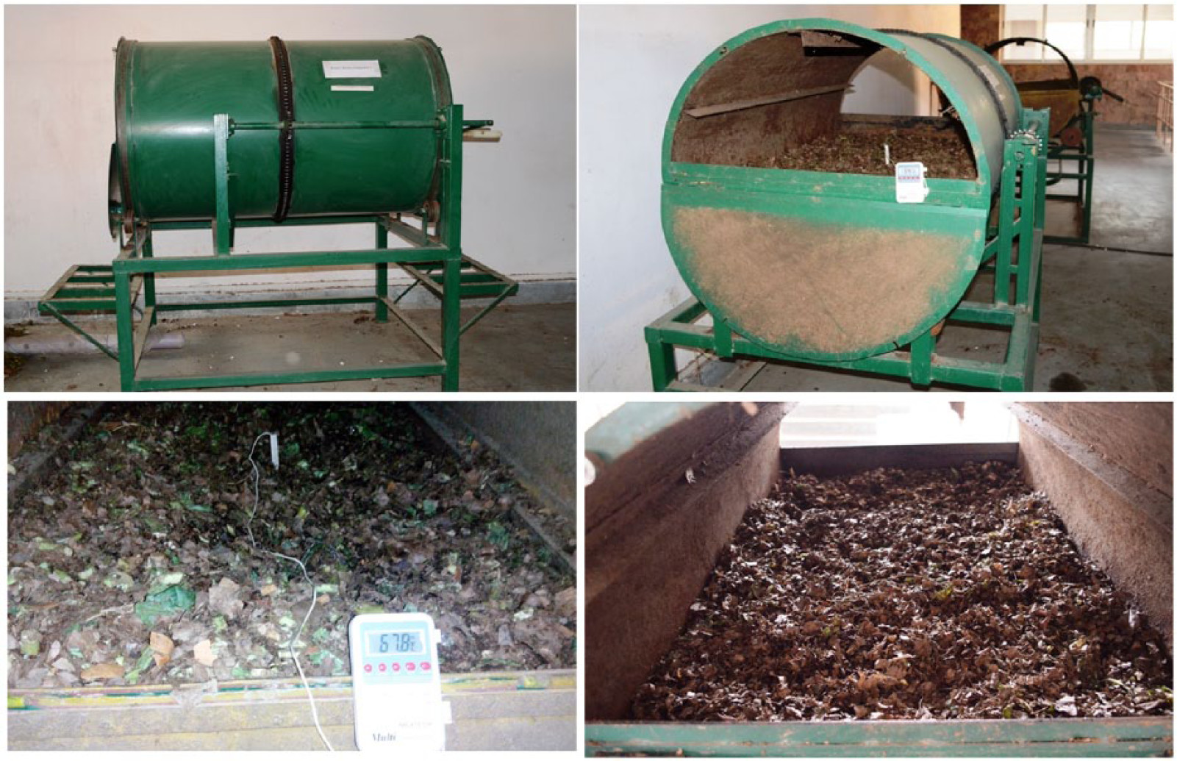
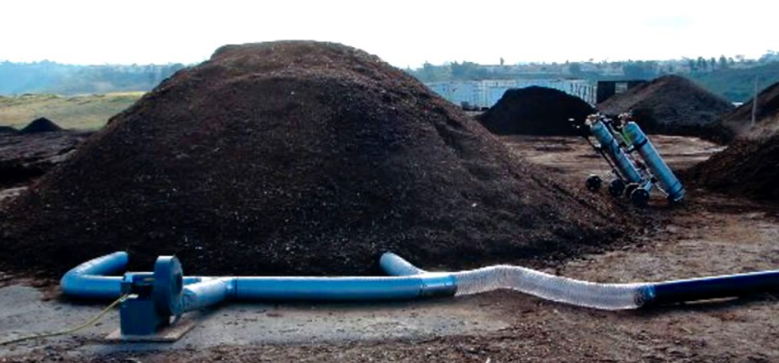
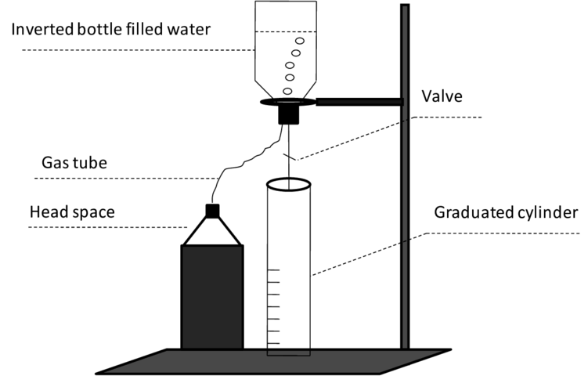

The Need
Aerobic Composting
Windrow
Fixed Dome
Biogas technologies
Floating drum
Aerated Static Pile (ASP)
In-vessel
Automated/controlled environment
Moisture Content
Temperature
Mixing/turning
pH
Phone operated
Inverted bottle lab-setup

Slide 4
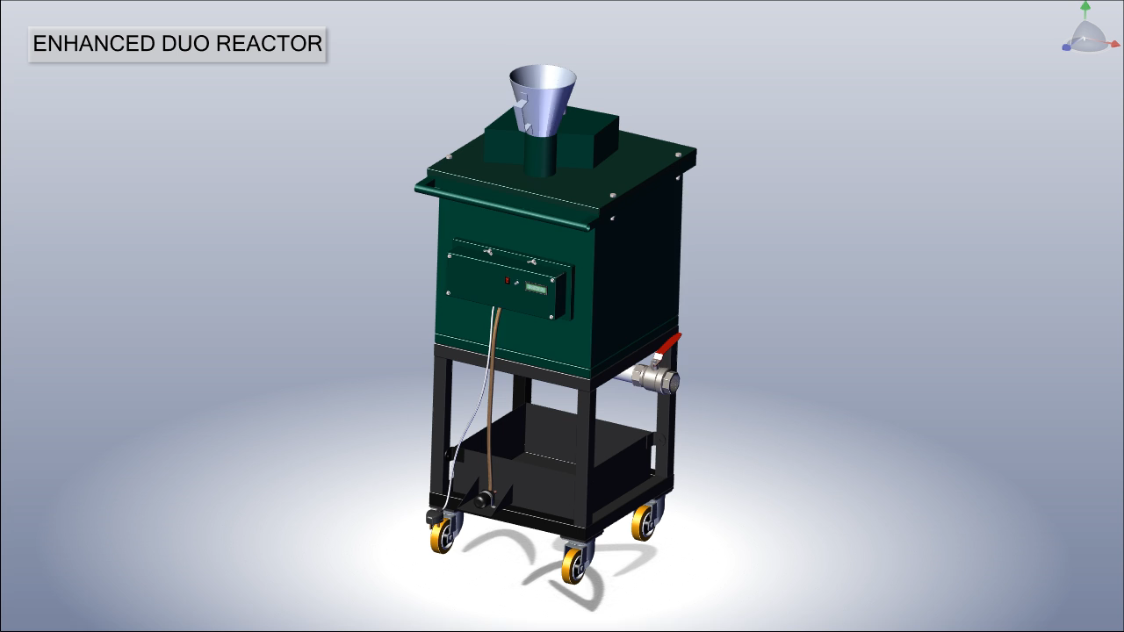
Concept

Slide 5
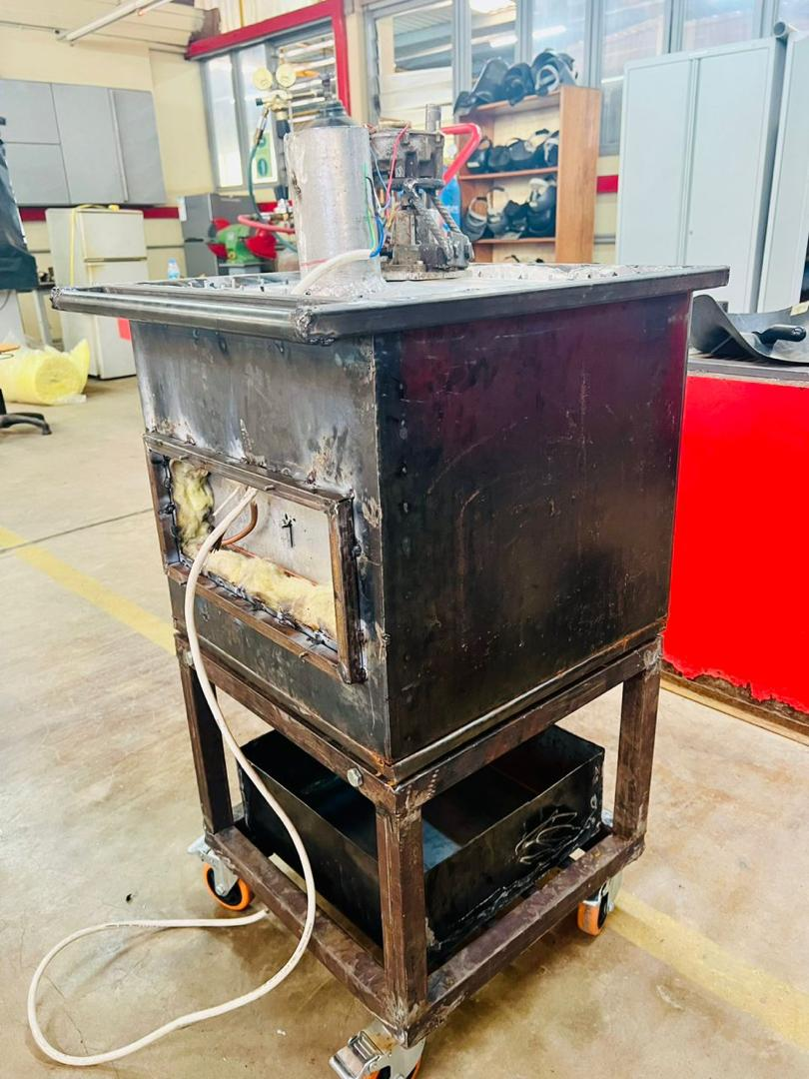
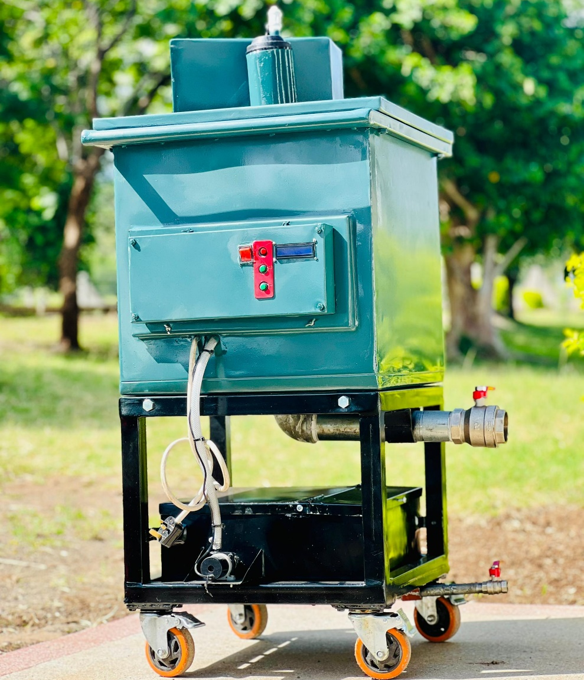
Current Prototype

Slide 6
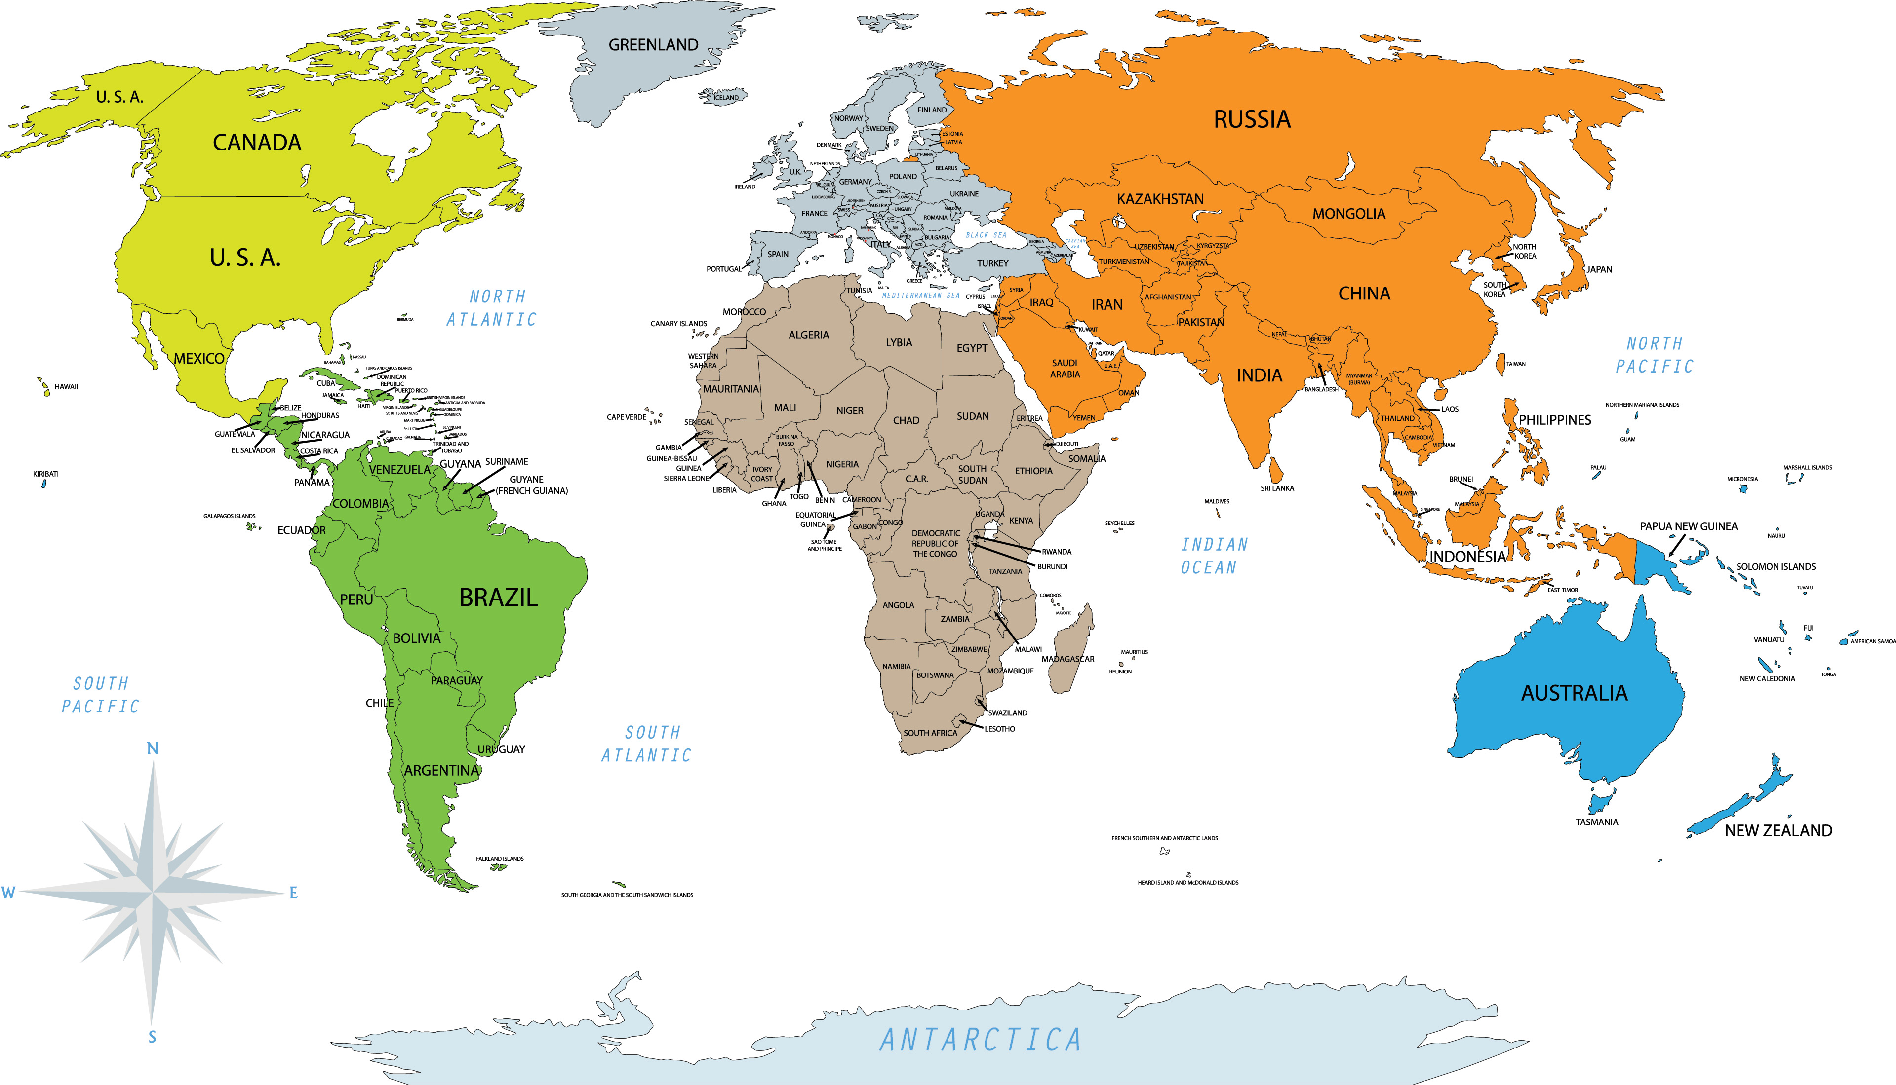
Market size/Potential

Slide 7
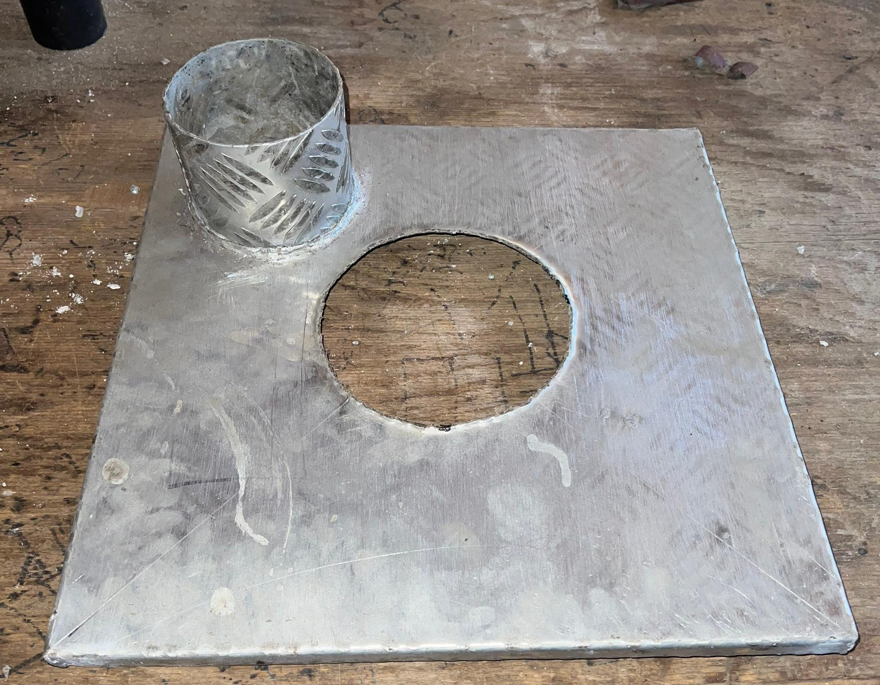
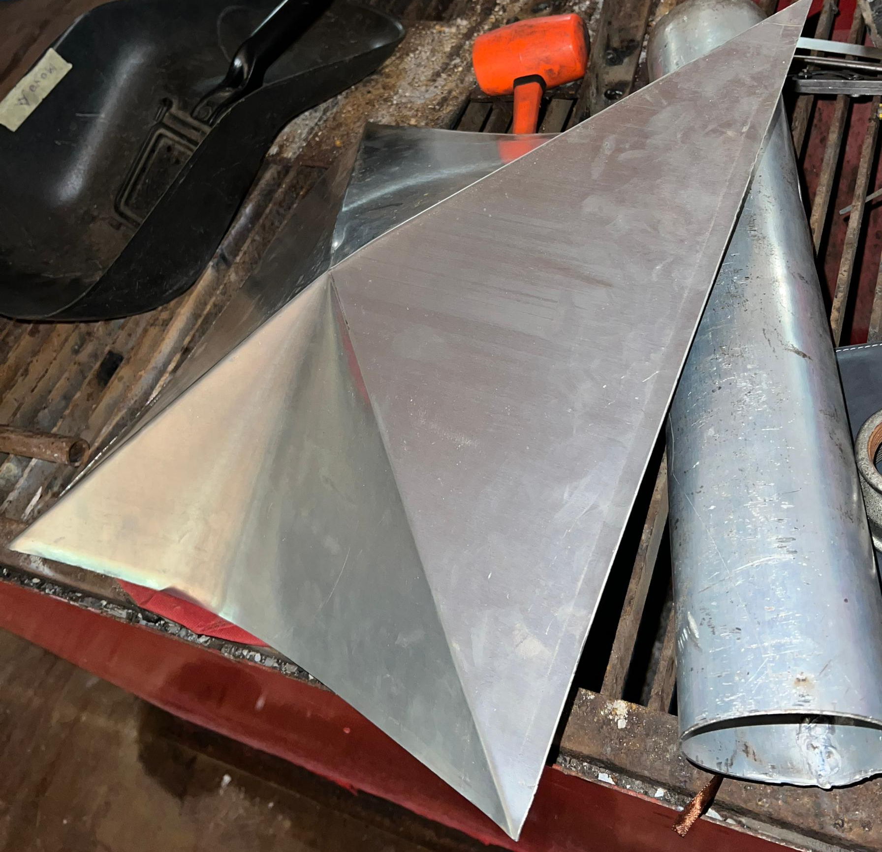
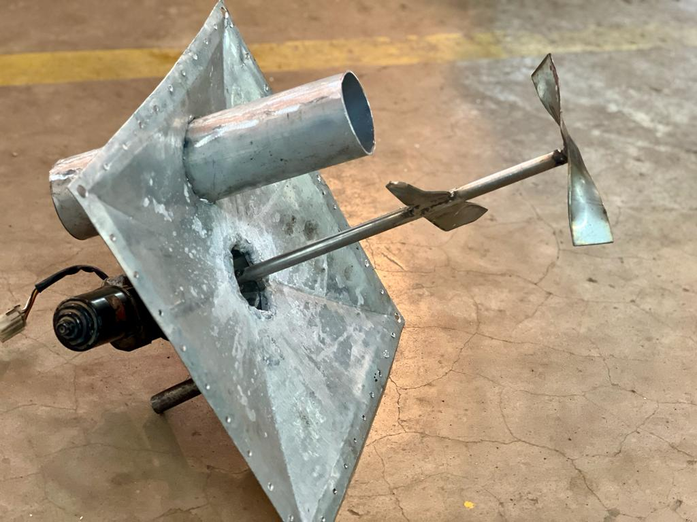
Encountered Challenges
1. Concept changes and Errors
2. Financial constraints
3. Demand for intensive supervision
Design and development costs (transport and meals), Production costs, modification/changes costs, and daily transport costs to & from ATC.
“Missing one day has implications for everything. Even with a common understanding yet, you have to be there, without that there is a high possibility of work repetition”
I hope NM-AIST will someday have a hybrid workshop (Mechanical, electrical, electronics) to assist researchers & innovators

Slide 8

Way forward
USD 16,000/= Seed fund
Innovation fund (4,000 USD)
- Perfecting EDR to fit for ARIPO & WIPO patenting.
Production of three EDR (12,000 USD)
- @ 4,000 USD, production cost
- To be sold to any three among ARU, UDSM, SUA, UDOM, DIT etc. @ 8,000 USD
“Project proposals__ Innovation and community centred projects”

Slide 9


